Slide 1
Lecture 5

Slide 2
Sinusoidal Waves
A continuous wave can be created by shaking the end of the string in simple harmonic motion
The shape of the wave is called sinusoidal since the waveform is that of a sine curve
The shape remains the same but moves
Toward the right in the text diagrams

Slide 3
Question 223.3.1
What is a crest?
A toothpaste
The place a wave crosses the x-axis
The peak of a wave
The lowest point in the wave

Slide 4
Amplitude and Wavelength
The crest of the wave is the location of the maximum displacement of the element from its normal position
This distance is called the amplitude, A
The point at the negative amplitude is called the trough
The wavelength, λ, is the distance from one crest to the next

Slide 6
Wavelength and Period
More generally, the wavelength is the minimum distance between any two identical points on adjacent waves
The period, T , is the time interval required for two identical points of adjacent waves to pass by a point
The period of the wave is the same as the period of the simple harmonic oscillation of one element of the medium

Slide 7
Frequency
The frequency, ƒ, is the number of crests (or any point on the wave) that pass a given point in a unit time interval
The time interval is most commonly the second
The frequency of the wave is the same as the frequency of the simple harmonic motion of one element of the medium

Slide 8
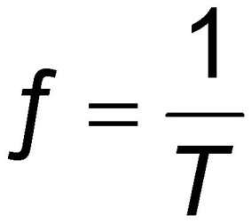
Frequency, cont
The frequency and the period are related
When the time interval is the second, the units of frequency are s⁻¹ = Hz
Hz is a hertz

Slide 11
Question 223.3.4
We know that frequency and period are inversely related. If the frequency is 0.2Hz what is the period?
20 sec
5 sec
2 sec
1 sec

Slide 12
Question 223.3.5
When we talk about the period of a sinusoidal wave, what do we mean?
Considering the snapshot view, it is the distance between wave crests
Considering the history graph view (video camera view), it is the period of oscillation of a single medium element.
Considering the snapshot view, it is the distance in maximum displacement between to medium points
Considering the history graph view, it is the distance between two wave crests.

Slide 13
Question 223.3.6
When we talk about the wavelength of a sinusoidal wave, what do we mean?
Considering the snapshot view, it is the distance between wave crests
Considering the history graph view (video camera view), it is the period of oscillation of a single medium element.
Considering the snapshot view, it is the distance in maximum displacement between to medium points
Considering the history graph view, it is the distance between two wave crests.

Slide 14
Question 223.3.8
What does k tell us?
How far apart wave crests are in distance
How often we get a wave crest in distance
How far apart wave crests are in time
How often we get a wave crest in time
Nothing

Slide 15
Wavenumber
Consider again a sinusoidal wave
A is the amplitude (x_{max}).
We need to find a (like for SHM we found ω).
Use initial conditions

Slide 16
Wavenumber
The next time y=0 will be when x=λ/2
This is true when
So
We have a special name for a, it is the wavenumber, and we give it the symbol k

Slide 17
From Alemily, licensed under the Creative Commons Attribution-Share Alike 2.5 Generic

Slide 18

About two furrows per meter

Slide 19

Thisisbossi https://commons.wikimedia.org/wiki/File:2008_03_28_-_I70_Cable_Barrier.JPG
Rumble Strip

Slide 20

Musical Rumble Strip Route 66

Slide 21
Question 223.3.3
I have a sinusoidal wave traveling with a wave speed of 10m/s. The wavelength is 5m. What is the frequency?
5m
2 sec
2 Hz
50 1/sec

Slide 24
Question 223.3.9
What shape are sound waves?
linear
circular
Spherical

Slide 25

Water Drop and wave From Julian Evil: Attribution-Share Alike 2.0 Generic

Slide 26

Portion of a Spherical Wave: Wave becomes more flat as it expands

Slide 27
END

Slide 28
Question 223.4.0.1
For sound waves, what is a compression?
It is a region of higher pressure
It is a region of lower pressure
It is an area over which a force is applied
It refers to the collision time of molecules

Slide 29
Question 223.4.0.2
For sound waves, a compression is a high pressure region, what do we call a low pressure region?
Low pressure region
Pressure minimimization
hypopresurization
Rarefaction

Slide 30
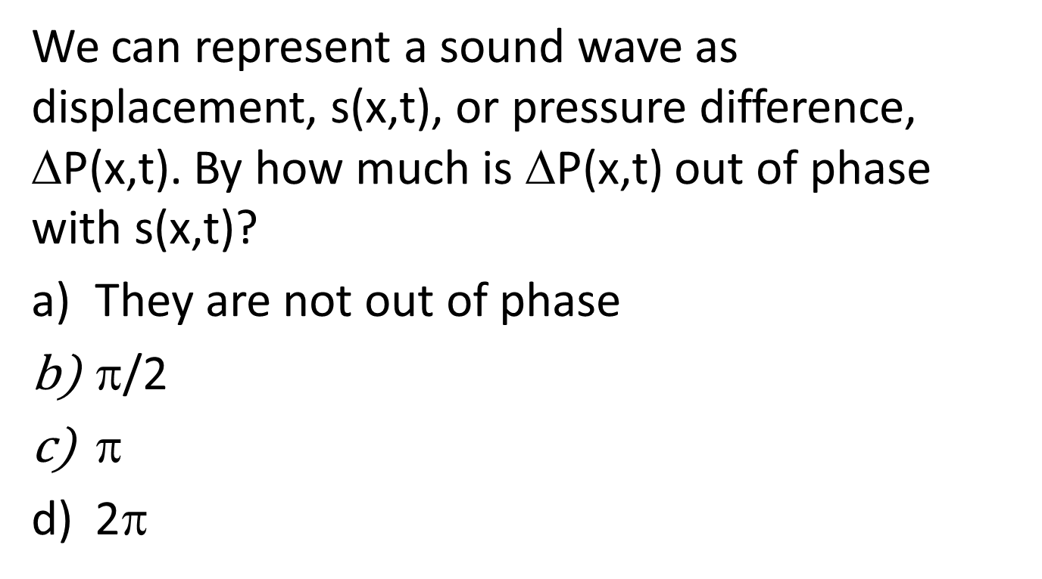
Question 223.4.0.3
We can represent a sound wave as displacement, s(x,t), or pressure difference, ΔP(x,t). By how much is ΔP(x,t) out of phase with s(x,t)?
They are not out of phase
$$/2
$$
2$$

Slide 32
Bar Graph of Displacement from Original Position

Slide 33
Wave Function
Propagating rarefaction
s
Fluid displaced to fill void
s_{max}
x

Slide 34
Pressure change is large here
Pressure change is almost zero here

Slide 35
Pressure is higher than normal here
Pressure is lower than normal here
Pressure change is almost zero here

Slide 36
Displacement
x
Change in Pressure
x

Slide 37
Question 223.4.2
The speed of sound in water is about 1.4km/s. Will the speed of sound be faster or slower in air?
Faster
Slower
Can’t tell

Slide 38
Question 223.4.2
Will sound travel faster on a hot day or a cold day?
Hot
Cold
Can’t tell

Slide 39
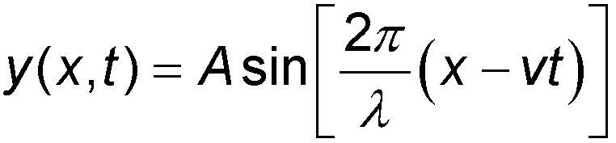
Speed of Waves
Waves travel with a specific speed
The speed depends on the properties of the medium being disturbed
The wave function is given by
This is for a wave moving to the right
For a wave moving to the left, replace x – vt with x + vt

Slide 40
θ
θ
T
T
θ

Slide 41
Forces on a Segment of String
Tension on the RHS of the element from the rest of the string on the right,
Tension on the LHS of the element from the rest of the string on the left
Force due to gravity
θ
θ
T
T
θ

Slide 42
Forces on a Segment of String
Assume that Δs an arc of a circle with radius R.
There is a force pulling left on the left end of the element that is tangent to the arc,
there is a force pulling right at the right end of the element which is tangent to the arc.
These forces produce centripetal accelerations
θ
θ
T
T
θ

Slide 43
Forces on a Segment of String
The horizontal components of the forces cancel
The vertical component, is directed toward the center of the arc
If the rope is not moving in the x direction, then
Then the force is
θ
θ
θ
θ
T
T
T
T
θ
θ

Slide 44
Forces on a Segment of String
Small Angle Aprox.
Define
so
θ
θ
T
T
θ

Slide 45
Forces on a Segment of String
Use Newton’ Second in Radial Direction
θ
θ
T
T
θ

Slide 46
Question 223.4.3
When a sound wave passes from air into water, what properties of the wave will change?
the frequency f
the wavelength λ
the speed of the wave
both f and λ
both v_{wave} and λ

Slide 47
Question 223.4.4
A wave travels across a boundary between two different weight ropes. If it goes from the heavier to the lighter rope, the wave speed
Increases
Decreases
Stays the same
Can’t tell

Slide 48
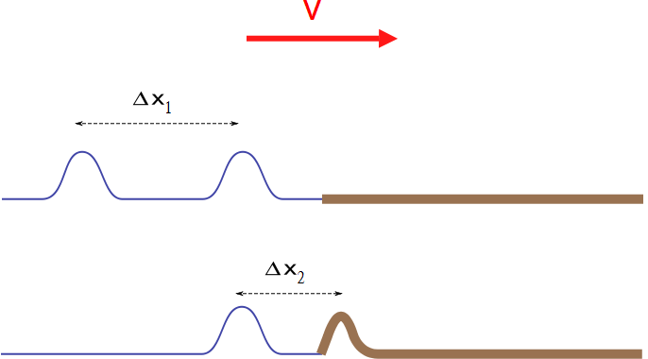

Slide 49
Question 223.4.4.5
Two ropes of different linear mass density are tied together. A sinusoidal wave goes from rope A rope where the wave speed is 4.0 m/s to rope B where the wave speed is 2.0 m/s. If the initial wave has a wavelength of 3.0 m, what is the wavelength in rope B?
2/3 m
3/2 m
3 m
6 m
1/6 m

Slide 50

Question 223.4.4.1
Can sound travel through space?
Yes
No
Only if you are George Lucas?

Slide 51
Question 223.4.4.2
Can light travel through space?
Yes
No

Slide 52
Question 223.4.4.3
What is the medium for a light wave?…
The electromagnetic field
Air molecules
Free space
Water molecules

Slide 53
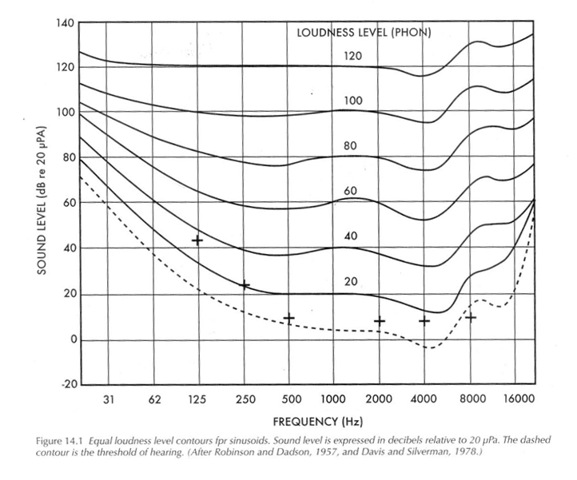
Frequency Response
William Strong and Grorge Plitnik, Music Speech Audio, 2nd. Ed.,BYU Academic Publishing, 2005

Slide 54
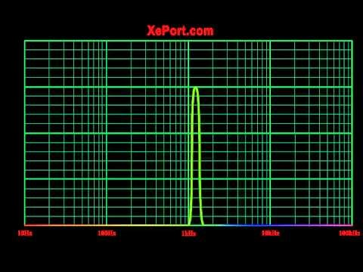

Slide 55
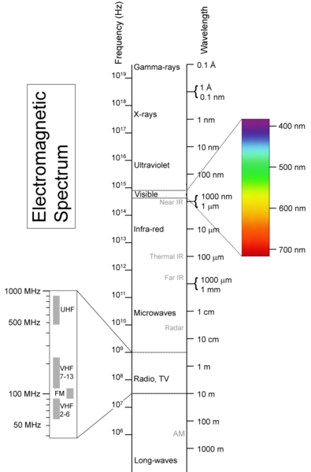
From Materialscientist, used under the Creative Commons Attribution-Share Alike 2.5 Generic License.

Slide 56
Question 223.3.2
Does a longitudinal wave, such as a sound wave, have an amplitude ?
a) yes
b) no
c) it depends on the medium the wave is in
air
pressure
λ
high
A
normal
low
x

Slide 57
Question 223.3.2.5
What do we mean when we say “amplitude” for a sound wave?
The maximum displacement from equilibrium of the molecule perpendicular to the wave direction.
The maximum displacement of one air molecule from it’s equilibrium point
The maximum distance an air particle travels

